Slide 1
Servlet

Slide 2


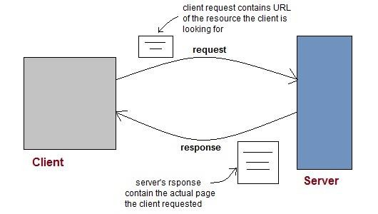
Web and Web Application
Web consists of billions of clients and server connected through wires and wireless networks.
The web clients make requests to web server. The web server receives the request, finds the resources and return the response to the client.
Mr. Nilesh Vishwasrao Patil

Slide 3

Web Application
A web application is an application accessible from the web.
A Web application is a web site with dynamic functionality on the server. Google, Facebook, Twitter are examples of web applications.
A web application is composed of web components like Servlet, JSP, Filter etc. and other components such as HTML.
The web components typically execute in Web Server and respond to HTTP request.

Slide 4

HTTP
HTTP is a protocol that clients and servers use on the web to communicate.
It is similar to other internet protocols such as SMTP (Simple Mail Transfer Protocol) and FTP (File Transfer Protocol) but there is one fundamental difference.
HTTP is a stateless protocol.
The client sends an HTTP request and the server answers with an HTML page to the client, using HTTP.

Slide 5

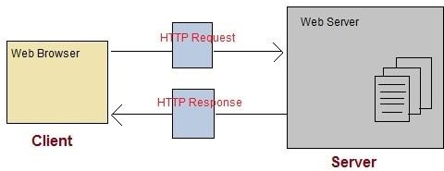
HTTP

Slide 6

 | HTTP methods
Method Name |  | Description
OPTIONS |  | Request for communication options that are available on the request/response chain.
GET |  | Request to retrieve information from server using a given URI.
HEAD |  | Identical to GET except that it does not return a message-body, only the headers and status line.
POST |  | Request for server to accept the entity enclosed in the body of HTTP method.
DELETE |  | Request for the Server to delete the resource.
CONNECT |  | Reserved for use with a proxy that can switch to being a tunnel.
PUT |  | This is same as POST, but POST is used to create, PUT can be used to create as well as update. It replaces all current representations of the target resource with the uploaded content.
Mr. Nilesh Vishwasrao Patil

Slide 7

HTTP methods
GET Request | POST Request
Data is sent in header to the server | Data is sent in the request body
Get request can send only limited amount of data | Large amount of data can be sent.
Get request is not secured because data is exposed in URL | Post request is secured because data is not exposed in URL.
Get request can be bookmarked and is more efficient. | Post request cannot be bookmarked.

Slide 8

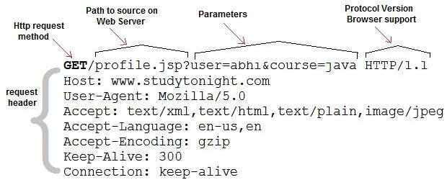
Anatomy of HTTP GET
Request
Get request contains path to server and the parameters added to it.

Slide 9
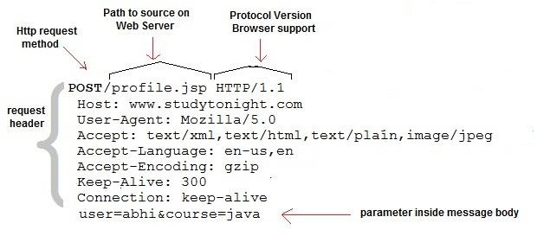
Anatomy of HTTP POST
Request
Post requests are used to make more complex requests on the server. For instance, if a user has filled a form with multiple fields and the application wants to save all the form data to the database. Then the form data will be sent to the server in POST request body, which is also known as Message body.

Slide 10

Servlet : Introduction
Servlet technology is used to create web application (resides at server side and generates dynamic web page).
Servlet is Java program which run on web server and responding to request of clients (Web browser).
Servlet technology is robust and scalable because of java language.

Slide 11

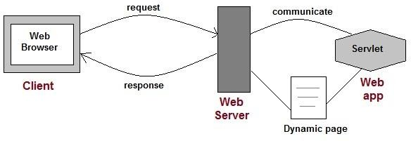
Servlet
Web applications are helper applications that resides at web server and build dynamic web pages.
A dynamic page could be anything like a page that randomly chooses picture to display or even a page that displays the current time.

Slide 12

Servlet : Defined in many ways
Servlet is a technology i.e. used to create web application.
Servlet is an API that provides many interfaces and classes including documentations.
Servlet is an interface that must be implemented for creating any servlet.
Servlet is a class that extend the capabilities of the servers and respond to the incoming request. It can respond to any type of requests.
Servlet is a web component that is deployed on the server to create dynamic web page.

Slide 13

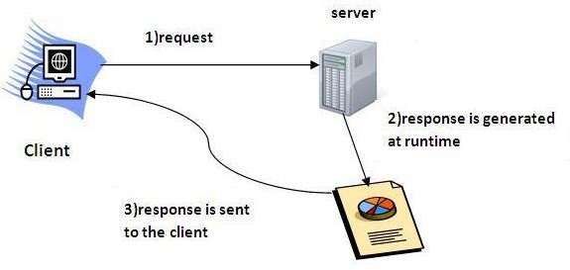
Servlet : Defined

Slide 14

CGI(Common Gateway
Interface)
CGI programming was used to create web applications.
Here's how a CGI program works :
  User clicks a link that has URL to a dynamic page instead of a static page.
  The URL decides which CGI program to execute.
  Web Servers run the CGI program in seperate OS shell. The shell includes OS enviroment and the process to execute code of the CGI program.
  The CGI response is sent back to the Web Server, which wraps the response in an HTTP response and send it back to the web browser.

Slide 15
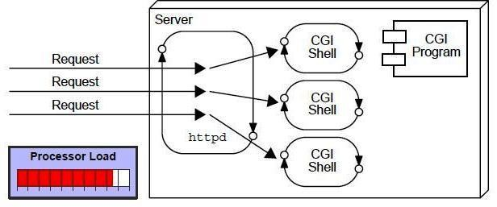
CGI(Common Gateway
Interface)

Slide 16
CGI(Common Gateway
Interface)
Disadvantages:
  If number of clients increases, it takes more time for sending response.
  For each request, it starts a process and Web server is
limited to start processes.
  It uses platform dependent language e.g. C, C++, perl.
  High response time because CGI programs execute in their own OS shell.
  CGI is not scalable.
  CGI programs are not always secure or object-oriented.
  It is Platform dependent.

Slide 17
Contrast of process vs. thread
Process
  Takes more time to
create
  More secure
  More fault tolerant
Thread
  Takes less time to
create
  Offers multiple threads of execution
  Share information
with other threads
  Less secure
  More vulnerable to crashes

Slide 18

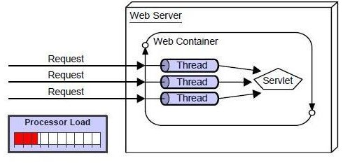
Servlet: Advantages over CGI

Slide 19

Servlet: Advantages over CGI
Less response time because each request runs in a separate thread.
Servlets are scalable.
Servlets are robust and object oriented.
Servlets are platform independent.

Slide 20

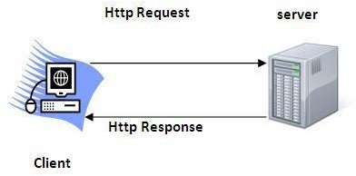
Servlet Terminologies :HTTP
Http is the protocol that allows web servers and browsers to exchange data over the web.
It is a request response protocol.
Http uses reliable TCP connections by default on TCP port 80.
It is stateless means each request is considered as the new request. In other words, server doesn't recognize the user by default.

Slide 21

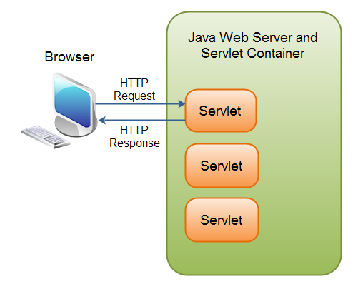
Servlet
A Java Servlet is a Java object that responds to HTTP requests. It runs inside a Servlet container.

Slide 22

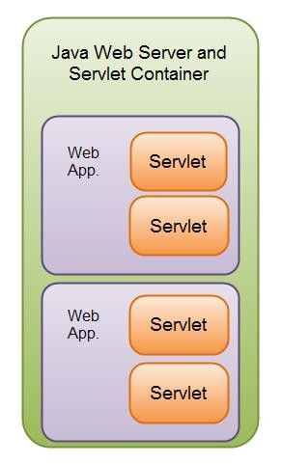
Servlet
A Servlet is part of a Java web application.
A Servlet container may run multiple web applications at the same time, each having multiple servlets running inside.

Slide 23

Servlet
A Java web application can contain other components than servlets.
It can also contain Java Server Pages (JSP), images, text files, documents, Web Services etc.

Slide 24

HTTP Request and Response
The browser sends an HTTP request to the Java web server.
The web server checks if the request is for a servlet. If it is, the servlet container is passed the request.
The servlet container will then find out which servlet the request is for, and activate that servlet.
The servlet is activated by calling the Servlet.service()method.
Once the servlet has been activated the servlet processes the request, and generates a response. The response is then sent back to the browser.

Slide 25

Servlet Containers
Java servlet containers are usually running inside a Java web
server.
Example: Tomcat, GlasssFish, Jboss etc.
Container:
  It provides runtime environment for JavaEE (j2ee) applications.
  It performs many operations that are given below:
    Life Cycle Management
    Multithreaded support
    Security etc.

Slide 26
Server
  It is a running program or software that provides services.
  Two types
    Web Server:
      Web server contains only web or servlet container. It can be used for servlet, jsp, struts, jsf etc. It can't be used for EJB.
      Example of Web Servers are: Apache Tomcat and Resin.
    Application Server:
      Application server contains Web and EJB containers. It can be used for
servlet, jsp, struts, jsf, ejb etc.
      Ex: Jboss, Glassfish, Weblogic, Websphere

Slide 27

Content Type
Content Type:
  Content Type is also known as MIME
(Multipurpose internet Mail Extension) Type.
  It is a HTTP header that provides the description about what are you sending to the browser.
text/html
text/plain
application/msword
application/vnd.ms-excel
application/jar
application/pdf
application/octet-stream
application/x-zip
images/jpeg
^{video/quick}M^{tim}r. ^{e}Nilesh Vishwasrao Patil
■

Slide 28

Types of Servlet
Generic Servlet:
  It is in javax.servlet.GenericServlet package
  It is protocol independent.
HTTP Servlet
  It is in javax.servlet.HTTPServlet package
  Built-in HTTP protocol support.

Slide 29

Types of Servlet
Generic Servlet | HTTP Servlet
Package: javax.servlet | Package: javax.servlet.http
It is protocol independent servlet | It is protocol dependent specifically only HTTP protocol request- response handle.
It uses service() method for handling request-response. | It uses methods like doPost(), doGet()

Slide 30

Servlet life cycle
Each servlet instance is loaded once.
Each execution happens in a separate thread
Three methods:
  init() : call only once to initialize servlet.
  service() : Call for every request.
  destroy() : call only once
Method service() is invoked every time a request comes. It spawns off threads to perform doGet or doPost based on the method invoked.

Slide 31
Servlet life cycle
1. Load Servlet Class.
2. Create Instance of Servlet.
3. Call the servlets init() method.
4. Call the servlets service() method.
5. Call the servlets destroy() method.
Note: Step 1,2,3 executed only once when servlet is initially loaded.
Step 4 executed "N"-times whenever http request comes
Step 5 executed to destroy servlet means unload servlet class

Slide 32
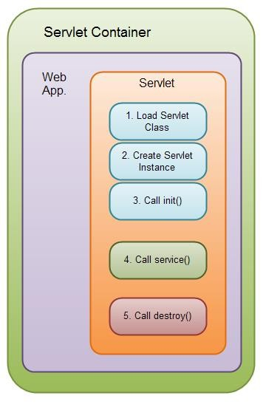

Servlet life cycle
Mr. N
ilesh Vishwasrao Patil

Slide 33

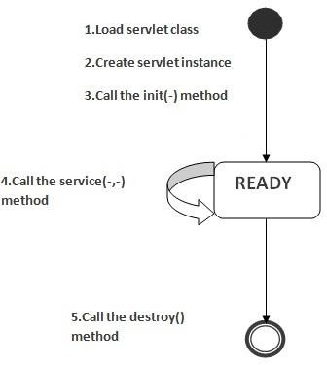
Servlet life cycle

Slide 34

Servlet API
Servlet API consists of two important packages that encapsulates all the important classes and interface, namely :
  javax.servlet
  javax.servlet.http

Slide 35

 |  | Servlet Interface: javax.servlet
Interfaces |  |  | Description
Servlet |  |  | Declare life cycle methods for servlet. To implement this interface we have to extends GenericServlet or HttpServlet classes.
ServletConfig |  |  | Helps servlet to get initialization parameter means startup information, basic information about servlet.
ServletContext |  |  | Allows servlet to log events and access information about their environment
ServletRequest |  |  | Used to read data from client
ServletResponse |  |  | Used to sent data to client

Slide 36

Servlet Classes: javax.servlet
Classes | Description
GenericServlet | Used to create servlet (Protocol independent)
ServletInputStream | Provides an input stream for reading requests from client.
ServletOutputStream | This class supports an output stream for writing responses to a client
ServletException | For handling exception: Error Occurred
UnavailableException | For handling exception: generate when servlet not available

Slide 37

Servlet Interface: javax.servlet.http
Classes | Description
HttpServlet | Used to create http servlet (Protocol dependent)
HttpServletRequest | It enables servlets to read data from an HTTP request
HttpServletResponse | It enables servlets to write data to an HTTP response
HttpSession | It allows to read and write session data.
Cookie | Cookie class allows state information to be stored on a client machine

Slide 38

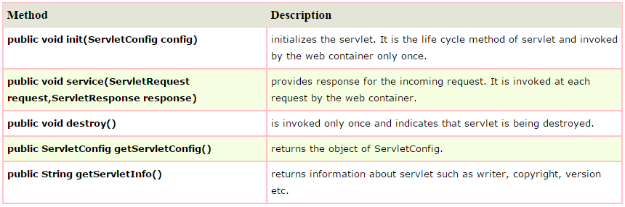
Servlet Interface: Methods

Slide 39

GenericServlet class
It implements Servlet, ServletConfig and
Serializable interfaces.
It provides the implementation of all the methods of these interfaces except the service method (You have to write code in your servlet class for this method).
GenericServlet class can handle any type of request so it is protocol-independent.

Slide 40
ServletConfig interface
Object of ServletConfig created by the web container for each servlet.
This object can be used to get configuration information from web.xml file.
Advantage: No need to edit the servlet file if information is modified from the web.xml file.

Slide 41
ServletConfig interface
public String getInitParameter(String name): Returns the parameter value for the specified parameter name.
Enumeration getInitParameterNames(): Returns all the initialized parameter names.
public String getServletName():
Returns the name of the servlet.
public ServletContext getServletContext():
Returns an object of ServletContext.

Slide 42
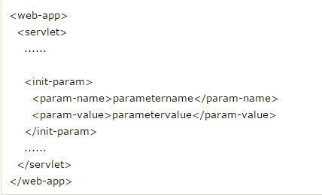
ServletConfig interface

Slide 43

ServletContext interface
An object of ServletContext is created by the web container at time of deploying the project (web application).
This object can be used to get configuration information from web.xml file.
There is only one ServletContext object per web application.

Slide 44

ServletContext interface
If any information is shared to many servlet, it is better to provide it from the web.xml file using the <context-param> element.
Usage:
  The object of ServletContext provides an interface between the
container and servlet.
  The ServletContext object can be used to get configuration information from the web.xml file.
  The ServletContext object can be used to set, get or remove attribute from the web.xml file.
  The ServletContext object can be used to provide inter-application communication.

Slide 45
ServletContext interface
<context-param>
<param-name>dname </param-name>
<param-value> sun.jdbc.odbc.JdbcOdbcDriver </param-value>
</context-param>

Slide 46

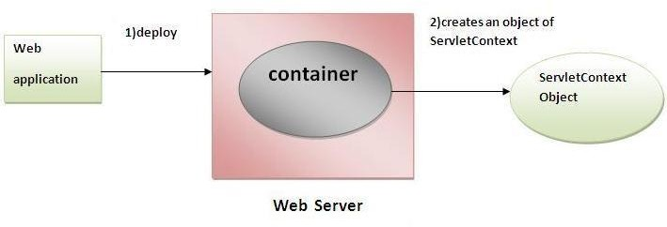
ServletContext interface

Slide 47

ServletConfig Vs ServletContext
Config | Context
One object per servlet | Object is global to entire web application
Object is created when servlet class is loaded | Object is created when web application deployed
It destroy when servlet is destroyed or upload the class. | It will destroyed when web application is un-deployed or removed.
Config object is public to particular servlet only. | It can share information between the servlet

Slide 48
HttpServlet
It extends GenericServlet class and implements Servlet, ServletConfig and Serializable interface.
It provides http specific methods such as doGet, doPost, doHead, doTrace etc.

Slide 49
HttpServlet
The most important are six doxxx methods that get called when a related HTTP request method is used.
The six methods are doPost, doPut, doGet, doDelete, doOptions and doTrace.
For instance, the doGet method is invoked when the servlet receives an HTTP request that was sent using the GET method.
Of the six doxxx methods, the doPost and the doGet methods are the most frequently used.

Slide 50
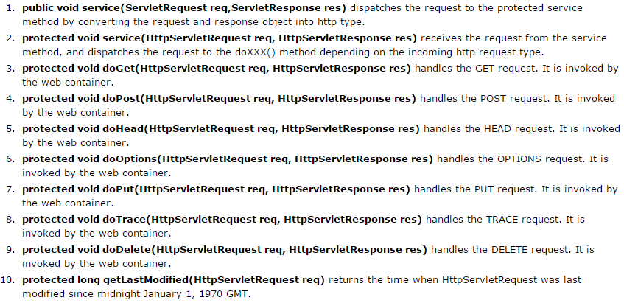
HttpServlet
Mr. Nilesh Vishwasrao Patil

Slide 51
Implementation
A Java Servlet is just an ordinary Java class which implements the interface
  javax.servlet.Servlet;
The easiest way to implement this interface is to extend either the
class GenericServlet or HttpServlet.

Slide 52
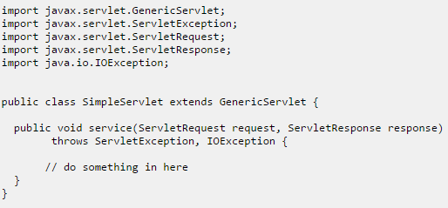
Example

Slide 53
Implementation
When an HTTP request arrives at the web server, targeted for your Servlet, the web server calls your Servlet's service() method.
The service() method then reads the request, and generates a response which is sent back to the client (e.g. a browser).

Slide 54
Implementation:HTTP
The javax.servlet.http.HttpServlet class is a slightly more advanced base class than
the GenericServlet
The HttpServlet class reads the HTTP request, and determines if the request is an HTTP GET, POST, PUT, DELETE, HEAD etc. and calls one the corresponding method.

Slide 55

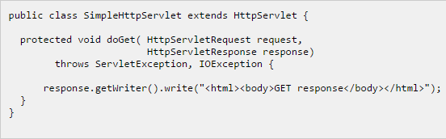
Implementation: HTTP

Slide 56

HttpRequest: Interface
This interface present in javax.servlet.http.HttpRequest
The purpose of the HttpRequest object is to represent the HTTP request a browser sends to your web application.

Slide 57

HttpRequest: Parameters
Thus, anything the browser may send, is accessible via the HttpRequest.
We can read initialization parameters also using HttpServletRequest object with getInitParameter method.

Slide 58

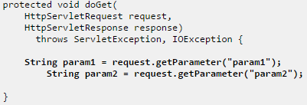
HttpRequest: Parameters
Also we can use following code if request parameters is send through body part of the Http request.
If the browser sends an HTTP GET request, the parameters are included in the query string in the URL.
If the browser sends an HTTP POST request, the parameters are included in the body part of the HTTP request.

Slide 59

HttpRequest: Header
The request headers are name, value pairs sent by the browser along with the HTTP request.
The request headers contain information about e.g. what browser software is being used, what file types the browser is capable of receiving etc. In short, at lot of meta data around the HTTP request.
Above example reads the Content-Length header sent by the browser.

Slide 60

HttpRequest: InputStream
If the browser sends an HTTP POST request, request parameters and other potential data is sent to the server in the HTTP request body.
If does not have sent data in parameters means may be binary data, that time we will require InputStream for accessing request body come from client.
InputStream requestBodyInput = request.getInputStream();
NOTE: You will have to call this method before calling any getParameter() method.

Slide 61
HttpRequest: Session
It is possible to obtain the session object from the HttpRequest object too.
The session object can hold information about a given user, between requests.
So, if you set an object into the session object during one request, it will be available for you to read during any subsequent requests within the same session time scope.

Slide 62

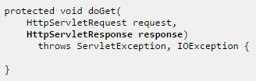
HttpResponse: Interface
This interface is present in java.servlet.http package.
The purpose of the HttpResponse object is to represent the HTTP response of web application sends back to the browser.

Slide 63


HttpResponse: Writing HTML
To send HTML back to the browser, you have to obtain the a PrintWriter from the HttpResponse object.

Slide 64
HttpResponse: Headers
Headers must be set before any data is written to the response.
Examples:
  Syntax:
response.setHeader("Header-Name", "Header Value");
  Set Content type:
response.setHeader("Content-Type", "text/html");
  Writing text
response.setHeader("Content-Type", "text/plain"); PrintWriter writer = response.getWriter(); writer.write("This is just plain text");
  Content-length
response.setHeader("Content-Length", "31642");

Slide 65
HttpResponse: Writing Binary
Data
We can also write binary data back to the browser instead of text.
For instance, we can send an image back, a PDF file or a Flash file or something like that.
First we have to set content type. And need to use following code:
OutputStream outputStream = response.getOutputStream(); outputStream.write(...);

Slide 66

HttpResponse: Redirecting
We can redirect the browser to a different URL from your servlet.
You cannot send any data back to the browser when redirecting response.sendRedirect("http://www.google.com");
Or Another servlet file call response.sendRedirect(“HelloServlet");

Slide 67


HttpSession
The HttpSession object represents a user session.
A user session contains information about the user across multiple HTTP requests.
When a user enters your site for the first time, the user is given a unique ID to identify his session by.
This ID is typically stored in a cookie or in a request parameter.

Slide 68

HttpSession
We can store values in the session object, and retrieve them later. Do it in following way:
session.setAttribute("userName", "theUserName");
This code sets an attribute named "userName", with the value "theUserName".
To read the value again:
String userName = (String) session.getAttribute("userName");
Values stored in the session object are stored in the memory of the servlet container.

Slide 69
HttpSession: In Clusters
If we have an architecture with 2 web servers in a cluster, keep in mind that values stored in the session object of one server, may not be available in the session object on the other server.
The solution to this problem would be one of:
  Do not use session attributes.
  Use a session database, into which session attributes are written, and from which it is read.
  Use sticky session, where a user is always sent to the same server,
throughout the whole session.

Slide 70

HttpSession: Example
Create one HTML file: index.html which send user name and password to the servlet file.
Create two servlet file, one will save user name into session and that session information is send to another servlet. This example shows the session tracking.

Slide 71

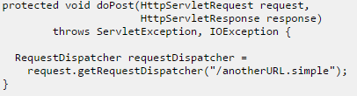
RequestDispatcher
The RequestDispatcher class enables your servlet to "call"
another servlet from inside another servlet.
We can obtain a RequestDispatcher from the HttpServletRequest object.
The above code obtains a RequestDispatcher targeted at whatever Servlet (or JSP) that is mapped to the URL /anotherUrl.simple.

Slide 72


RequestDispatcher
You can call the RequestDispatcher using either its include() or forward() method.
The forward() method intended for use in forwarding the request, meaning after the response of the calling servlet has been committed. You cannot merge response output using this method.
The include() method merges the response written by the calling servlet, and the activated servlet. This way you can achieve "server side includes" using the include().

Slide 73
Servlet: Load on start up
The <servlet> element has a sub-element called
<load-on-startup> which you can use to control when the servlet container should load the servlet.
If you do not specify a <load-on-startup> element, the servlet container will typically load your servlet when the first request arrives for it.
By setting a <load-on-startup> element, you can tell the servlet container to
load the servlet as soon as the servlet container starts.
Remember, the servlets init() method is called when the servlet is loaded.
<load-on-startup>1</load-on-startup>

Slide 74
Cookie
HTTP Cookies are little pieces of data that a web application can store on the client machine of users visiting the web application.
Typically up to 4 kilo bytes(KB) of data can be store.
We can write cookies using HttpServletResponse object:
Example:
Cookie cookie = new Cookie("myCookie", "myCookieValue"); response.addCookie(cookie);

Slide 75

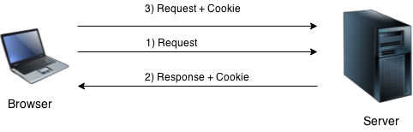
Cookie
By default, each request is considered as a new request.
In cookies technique, we add cookie with response from the servlet.
So cookie is stored in the cache of the browser.
After that if request is sent by the user, cookie is added with request by default. Thus, we recognize the user as the old user.

Slide 76

Cookie: Types
Non-persistent cookie:
  It is valid for single session only. It is removed each time when user closes the browser.
Persistent cookie:
  It is valid for multiple session . It is not removed each time when user closes the browser. It is removed only if user logout or sign-out or clear cookies/cache memory of browsers.

Slide 77
Cookie: Pros/Cons
Advantages:
  Simplest technique of maintaining the state.
  Cookies are maintained at client side.
Disadvantages
  It will not work if cookie is disabled from the browser.
  Only textual information can be set in Cookie object.

Slide 78
Cookie: Constructor
javax.servlet.http.Cookie class provides the functionality of using cookies. It provides a lot of useful methods for cookies.
Constructor | Description
Cookie() | constructs a cookie.
Cookie(String name, String value) | constructs a cookie with a specified name and value.

Slide 79
Cookie: Methods
Useful methods:
Method | Description
public void setMaxAge(int expiry) | Sets the maximum age of the cookie in seconds.
public String getName() | Returns the name of the cookie.
public String getValue() | Returns the value of the cookie.
public void setName(String name) | changes the name of the cookie.
public void setValue(String value) | changes the value of the cookie.

Slide 80

Cookie: Methods
Other methods:
public void addCookie(Cookie ck):method of HttpServletResponse interface is used to add cookie in response object.
public Cookie[] getCookies():method of HttpServletRequest interface is used to return all the cookies from the browser.

Slide 81

Cookie: How to create?
Creating cookie object
Cookie ck=new Cookie("user",”Sandip");
Adding cookie in the response
response.addCookie(ck);//

Slide 82
Cookie: For delete Cookies
Deleting value of cookie
Cookie ck=new Cookie("user","");
Changing the maximum age to 0 seconds
ck.setMaxAge(0);
Adding cookie in the response
response.addCookie(ck);

Slide 83

Cookie: To get Cookies
Cookie ck[]=request.getCookies();
for(int i=0;i<ck.length;i++)
{
out.print("<br>"+ck[i].getName()+" "+ck[i].getValue());
//printing name and value of cookie
}

Slide 84

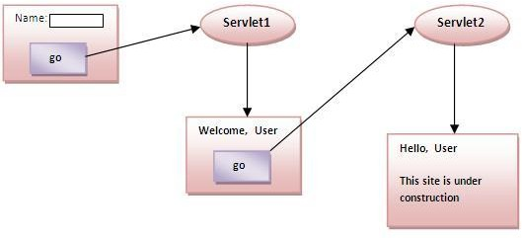
Cookie: Example

Slide 85

Cookie: Example
Create one Html file which send user name to first servlet.
First servlet file set cookies of that user name and call second servlet file.
Second servlet file retrieve name of user from cookies instead of from session.

Slide 86

MCQ
Which is of the following are classes and which are interfaces?
  1. Servlet
  2. ServletConfig
  3. ServletRequest
  4. ServletResponse
  5. HttpServlet
  6. GenericServlet
  7. Cookies
  8. Session

Slide 87
MCQ
What is returntype of the getSession() method?
  1. Session
  2. int
  3. HttpSession
  4. boolean
  5. void

Slide 88
MCQ
Javax.servlet packages does not have:
  1. HttpServlet
  2. ServletConfig
  3. ServletContext
  4. Servlet
  5. HttpServletRequest
  6. ServletResponse
  7. HttpServletResponse
  8. Cookies

Slide 89
MCQ
Javax.servlet packages does not have:
  1. HttpServlet
  2. ServletConfig
  3. ServletContext
  4. Servlet
  5. HttpServletRequest
  6. ServletResponse
  7. HttpServletResponse
  8. Cookies

Slide 90
MCQ
Which is correct package for HttpServlet and HttpServletResponse?
  1. javax.servlet.*;
  2. javax.servlet.http.*;
  3. javax.servlet.httpservlet.*;
  4. java.lang.*;

Slide 91

MCQ
Which of the following method is invoked when Http post request?
  1. doPost()
  2. doPostCall()
  3. doHttpPost()
  4. doPut()
  5. doTrace()
  6. doPostOptions()

Slide 92

MCQ
Which of the following method is invoked when Http post request?
  1. doPost()
  2. doPostCall()
  3. doHttpPost()
  4. doPut()
  5. doTrace()
  6. doPostOptions()

